Slide 1
NC73 Council of Planning
Regular Meeting
October 26th, 2023
11:00 AM – 12:00 PM

Slide 2
Meeting Agenda
Agenda Item | Lead | Time
Welcome & Introductions | Luke Lowry, Centralina | 5 minutes
Administrative Matters Approval of minutes from April 6th, 2023 | Luke Lowry, Centralina | 5 minutes
NCDOT Updates | Theo Ghitea, NCDOT | 20 minutes
Around the Room Each community will give a brief update of what is taking place along their respective portions of the corridor | Luke Lowry, Centralina | 25 minutes
Wrap-Up and Adjourn | Luke Lowry, Centralina | 5 minutes

Slide 3
Welcome & Introductions

Slide 4
Administrative Matters

Slide 5
Administrative Matters
Meeting Minutes from the previous meeting (April 6th, 2023) are attached the meeting hold in Outlook

Slide 6
Updates from NCDOT

Slide 7
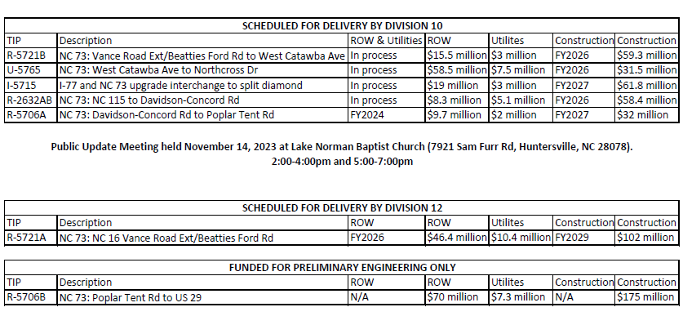
Updates from NCDOT

Slide 8
Around the Room
Notes:
A few engagement questions:
- What are the current trends you are seeing regarding land use / transportation connections?
- Are there any particular barriers / opportunities to land use / transportation connection for your communities?
- What resources/education do you need?

Slide 9
Wrap Up & Adjourn

Slide 10
THANK YOU
Luke Lowry, Centralina Regional Council, llowry@centralina.org
NC 73 Council of Planning website: https://nc73.net/

